Slide 1
STUDENTS’ RECORDS MANAGEMENT SYSTEM

Slide 2
INTRODUCTION
Every setup environment currently needs application system to assist with their functions. University isn’t going to be left behind in this technological development.
A students records management is an application that the university has planned on for a while now, and the management feels they are ready to implement and execute it at this time.
The institution has contracted our firm to help with the implementation, installation, commissioning and maintenance of this application system
In this write up, we present an overview of how the database system would look like together with the various building block entities.
Notes:
A business process is a collection of linked tasks that find their end in the delivery of a service or product to a client. A business process has also been defined as a set of activities and tasks that, once completed, will accomplish an organizational goal.Operational processes constitute the core business.

Slide 3
ENVIRONMENTAL SETUP
An institution of higher learning, University, that is interested in setting up a students’ records management system.
There exists over ten different university sections that the students can have access to. The academic section (core mandate) has a total of over ten faculties, with each faculty having a minimum of 4 departments.
A student is issued with an admission number upon acceptance of the application by the selection committee.
Notes:
A business process is a collection of linked tasks that find their end in the delivery of a service or product to a client. A business process has also been defined as a set of activities and tasks that, once completed, will accomplish an organizational goal.Operational processes constitute the core business.

Slide 4
PURPOSE OF THE SYSTEM
Integrate activities around the students into a single source. All the student’s information can be accessed from a single stop-over.
Leverage on the administration on holistically monitoring each student. A single click will provide all the necessary information of several students.
The accessibility of the system from any location. The database system will be distributed and embedded onto an IP address.
Total data protection guaranteed.
Improved operations productivity, thus saving on both time and money.
Notes:
A business process is a collection of linked tasks that find their end in the delivery of a service or product to a client. A business process has also been defined as a set of activities and tasks that, once completed, will accomplish an organizational goal.Operational processes constitute the core business.

Slide 5
THE SYSTEM FEATURES
The proposed system to be developed will be user-friendly.
The system shall have encryption/decryption features to limit accessibility by unauthorized personnel.
Only the administrators and other authorized personnel will have an access to the system backbone. The system configuration will support this
Notes:
Here we detail about the six major objectives of planning in India, i.e., (a) Economic Growth, (b) Attaining Economic Equality and Social Justice, (c) Achieving Full Employment, (d) Attaining Economic Self-Reliance, (e) Modernization of Various Sectors, and (f) Redressing Imbalances in the Economy.

Slide 6
SYSTEM BUILDING BLOCKS (MODULES AND SUB MODULES)
Registration Entity: demographic data of the student including the admission number and parents/guardian details.
Finance Entity: students’ accounts information
Health Entity: Existing medical conditions together with the hospital registration details.
Cafeteria Entity: Meals offered by the institution together with the price tags.
Notes:
All the operations related to Accounts, is managed by this module. Saving Account Module : Saving Account Module is used to manage the Saving Account. Current Account Module : It has been developed for managing the Current Account. Customer Module : It manages the Customer.

Slide 7
SYSTEM BUILDING BLOCKS (MODULES AND SUB MODULES) cont…
Games/Sports Entity: all the available sporting activities with the student’s choice of sports.
Accommodation Entity: students hostel of residence and other related information.
Academic Entity: Lectures and Examination sub-modules. Includes students attendance records, course units, lecturer, exams administered and the results.
Notes:
All the operations related to Accounts, is managed by this module. Saving Account Module : Saving Account Module is used to manage the Saving Account. Current Account Module : It has been developed for managing the Current Account. Customer Module : It manages the Customer.

Slide 8
THE ENTITY RELATIONSHIP DIAGRAM (ERD)
Name
Adm.
ID
Adm.
Sem
Activity
Parents
Registration
Year
Sports
Email
Accepts
Reg
Adm.
Hostel
Adm.
Fee
Adm.
Sem
Book
Accommodation
Year
Reg
Admission
Fee
Cafeteria
Sem
Year
Reg
Adm.
Reg
Prog
Adm.
Reg
Academics
Course
IP/OP
Year
Prog
Health
Lecturer
Results
Parents
Finance
Adm.
Exams
Prog
Sem
Year
Fee
Notes:
Here we detail about the six major objectives of planning in India, i.e., (a) Economic Growth, (b) Attaining Economic Equality and Social Justice, (c) Achieving Full Employment, (d) Attaining Economic Self-Reliance, (e) Modernization of Various Sectors, and (f) Redressing Imbalances in the Economy.

Slide 9
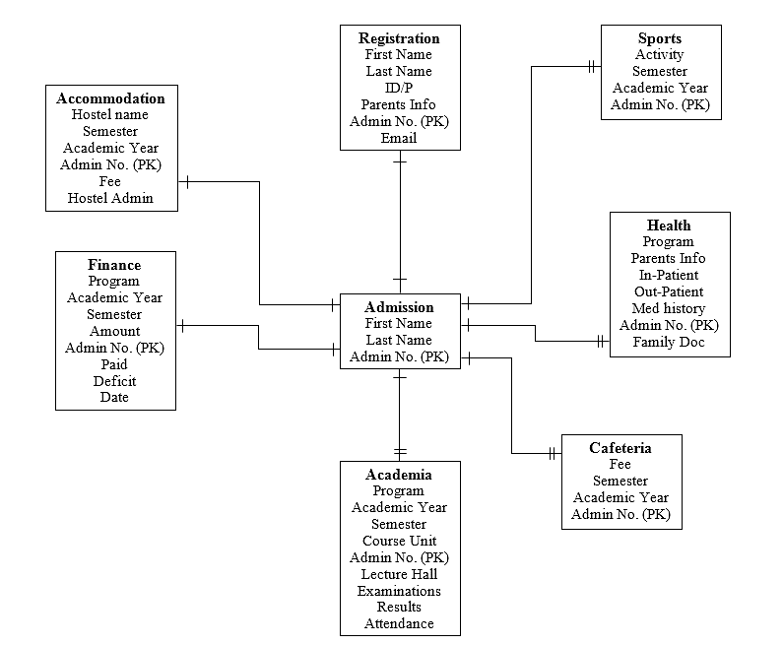
THE DATA DIMENSIONAL MODEL
Notes:
Here we detail about the six major objectives of planning in India, i.e., (a) Economic Growth, (b) Attaining Economic Equality and Social Justice, (c) Achieving Full Employment, (d) Attaining Economic Self-Reliance, (e) Modernization of Various Sectors, and (f) Redressing Imbalances in the Economy.

Slide 10
TECHNICAL CONSTRAINTS
The system is totally web-based, therefore Apache or Oracle Servers would be used.
MySQL would be deployed in developing the systems database.
MySQL is an open source database application that is secure and user friendly.
Technical skills are required to effectively install and operate MySQL on any Server.
Notes:
Firms are defined as constrained if they applied for bank loans, bank overdrafts, credit lines or credit card overdrafts and were made an offer, but rejected the offer due to the cost being too high.

Slide 11
LOGICAL DESIGN OF THE DATABASE
Each Entity listed in the building blocks shall have the following features
Tables
Attributes
Keys
Data Types
Notes:
Banking management system logical design of the database are represents as tables, attributes, keys, datatypes.

Slide 12
LOGICAL DESIGN OF THE DATABASE cont…
Finance: Program, Admission Number (PK), Semester, Amount, Paid, Deficit, Date
Academia: Admission Number (PK), Academic Year, Semester, Course Unit, Lecture Hall, Examinations, Results, Attendance
Notes:
Banking management system logical design of the database are represents as tables, attributes, keys, datatypes.

Slide 13
LOGICAL DESIGN OF THE DATABASE cont…
Admission: Admission Number (PK), First and Last Name
Registration: Admission Number (PK), ID/Passport, Parent Information, First and Last Name, Email
Sports: Admission Number (PK), Academic Year, Semester, Activity participating in
Health: Admission Number (PK), In-Patient (FK), Out-Patient (FK), Medical History, Family Doc, Program, Parents Info
Cafeteria: Admission Number (PK), Fee, Semester, Academic Year
Accommodation: Admission Number (PK), Hostel name, Semester, Academic Year, Fee, Hostel Admin
Notes:
Banking management system logical design of the database are represents as tables, attributes, keys, datatypes.

Slide 14
NETWORK INFRASTRUCTURE & SECURITY
The use of fiber-optic cable as the university’s network backbone connecting all the sections and faculties
Use of Ethernet cables for departmental network setups.
Deployment of Access Points in various designated places within the university’s premise.
Configuring various authentication and authorization network credentials.
Use of firewalls to safeguard the network from external spooning
User of burglar proofing technique to safeguard the physical server rooms.
Notes:
Here we detail about the six major objectives of planning in India, i.e., (a) Economic Growth, (b) Attaining Economic Equality and Social Justice, (c) Achieving Full Employment, (d) Attaining Economic Self-Reliance, (e) Modernization of Various Sectors, and (f) Redressing Imbalances in the Economy.

Slide 15
SYSTEM EXAMINATION PLAN
Audit Type | When / frequency | Audit by | Applicability
Start Audit | Project beginning | SQA | ALL types of projects
Work product audit | Before each deliverable(in case of Development/Large Maintenance Work) | QL | Not applicable to Application support/Infrastructure management Service/ERP Production Support:
Process audit | Once in a month | QL | ALL types of projects
Closure audit | After project completion/ once in six months (in case of long maintenance/support projects) | SQA | ALL types of projects
Configuration audit | Once in a month | CL/QL | Combined with Process audit
Additional audit (Audits executed/expected by Client as per contract) | Event Based | External experts | Optional
Notes:
Here we detail about the six major objectives of planning in India, i.e., (a) Economic Growth, (b) Attaining Economic Equality and Social Justice, (c) Achieving Full Employment, (d) Attaining Economic Self-Reliance, (e) Modernization of Various Sectors, and (f) Redressing Imbalances in the Economy.

Slide 16
CADENT PLAN
Used for analyzing, monitoring & controlling the project’s performance to ensure that all the project’s objectives are met.
Collected periodically.
Notes:
Here we detail about the six major objectives of planning in India, i.e., (a) Economic Growth, (b) Attaining Economic Equality and Social Justice, (c) Achieving Full Employment, (d) Attaining Economic Self-Reliance, (e) Modernization of Various Sectors, and (f) Redressing Imbalances in the Economy.

Slide 17
DEFECT PREVENTION
Encompasses identification and analysis of commonly caused defects in projects.
Various meetings scheduled to discuss the mitigation measures.
Notes:
Here we detail about the six major objectives of planning in India, i.e., (a) Economic Growth, (b) Attaining Economic Equality and Social Justice, (c) Achieving Full Employment, (d) Attaining Economic Self-Reliance, (e) Modernization of Various Sectors, and (f) Redressing Imbalances in the Economy.

Slide 18
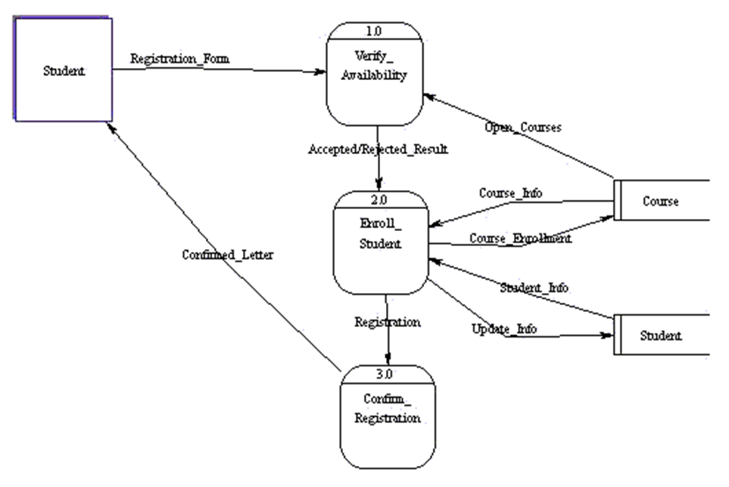
DATA FLOW DIAGRAMS (DFDs) STUDENT REGISTRATION DFD
Notes:
Here we detail about the six major objectives of planning in India, i.e., (a) Economic Growth, (b) Attaining Economic Equality and Social Justice, (c) Achieving Full Employment, (d) Attaining Economic Self-Reliance, (e) Modernization of Various Sectors, and (f) Redressing Imbalances in the Economy.

Slide 19
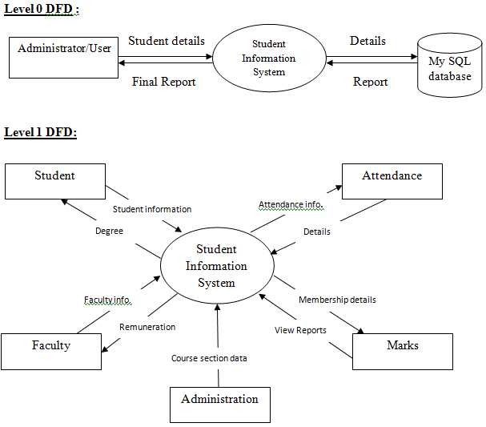
DATA FLOW DIAGRAMS (DFDs) STUDENT RECORDS DFD
Notes:
Here we detail about the six major objectives of planning in India, i.e., (a) Economic Growth, (b) Attaining Economic Equality and Social Justice, (c) Achieving Full Employment, (d) Attaining Economic Self-Reliance, (e) Modernization of Various Sectors, and (f) Redressing Imbalances in the Economy.

Slide 20
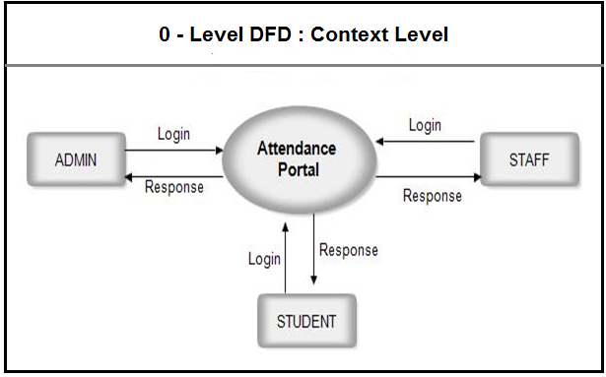
DATA FLOW DIAGRAMS (DFDs) LOGINS DFD
Notes:
Here we detail about the six major objectives of planning in India, i.e., (a) Economic Growth, (b) Attaining Economic Equality and Social Justice, (c) Achieving Full Employment, (d) Attaining Economic Self-Reliance, (e) Modernization of Various Sectors, and (f) Redressing Imbalances in the Economy.

Slide 21
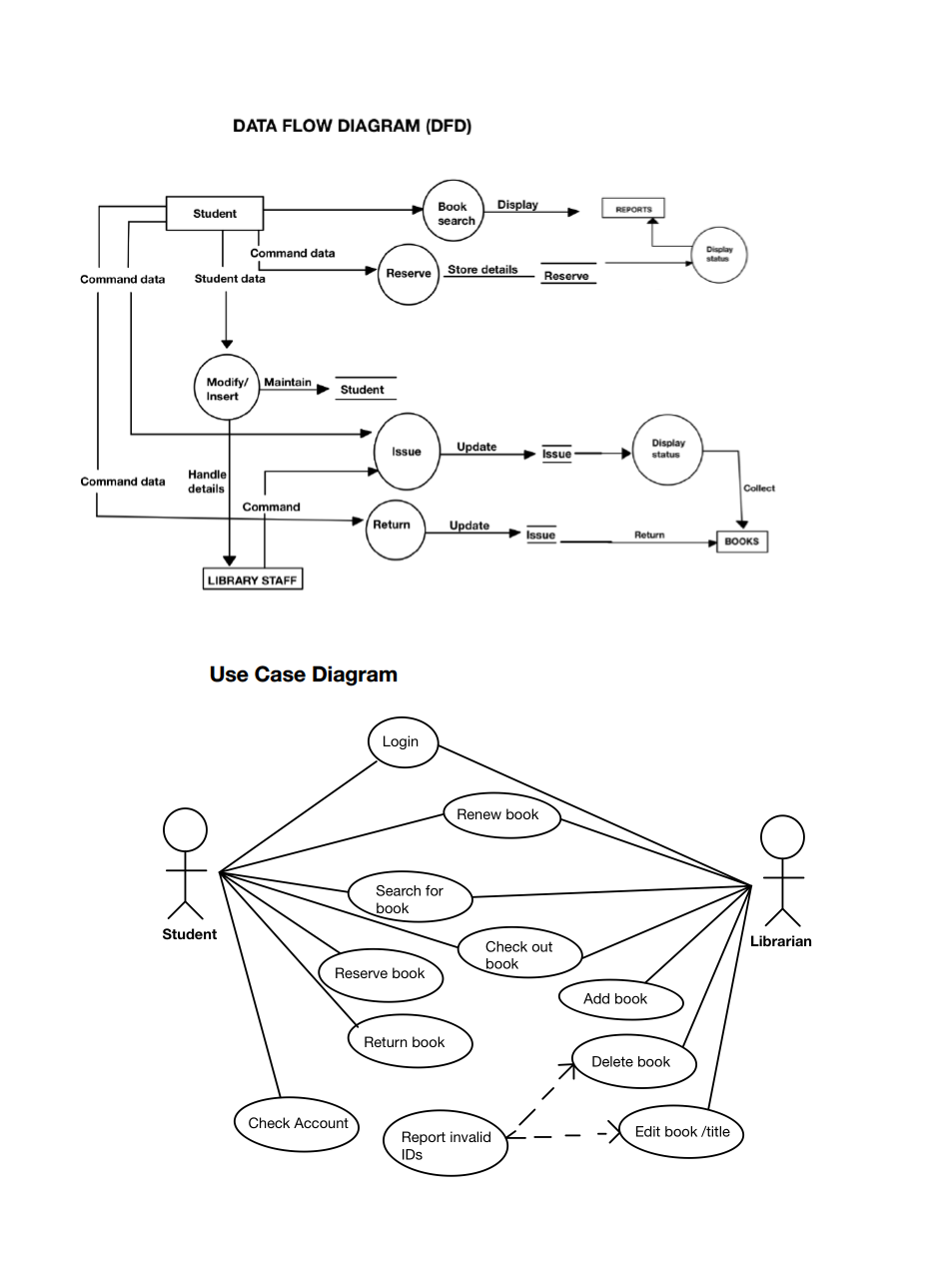
DATA FLOW DIAGRAMS (DFDs) DFD & USE CASE DIAGRAM FOR THE LIBRARY COMPONENT
Notes:
Here we detail about the six major objectives of planning in India, i.e., (a) Economic Growth, (b) Attaining Economic Equality and Social Justice, (c) Achieving Full Employment, (d) Attaining Economic Self-Reliance, (e) Modernization of Various Sectors, and (f) Redressing Imbalances in the Economy.

Slide 22
CONCLUSION
We have presented an overview of the system to be developed in this write up.
We project to continue to database modelling and development from this write up.
All the necessary database building blocks have adequately been discussed in this write up.
We will implement the database on MySQL and have the application developed using PhP web development tool (Both front and back end).
Notes:
A business process is a collection of linked tasks that find their end in the delivery of a service or product to a client. A business process has also been defined as a set of activities and tasks that, once completed, will accomplish an organizational goal.Operational processes constitute the core business.

Slide 23


